Slide 1
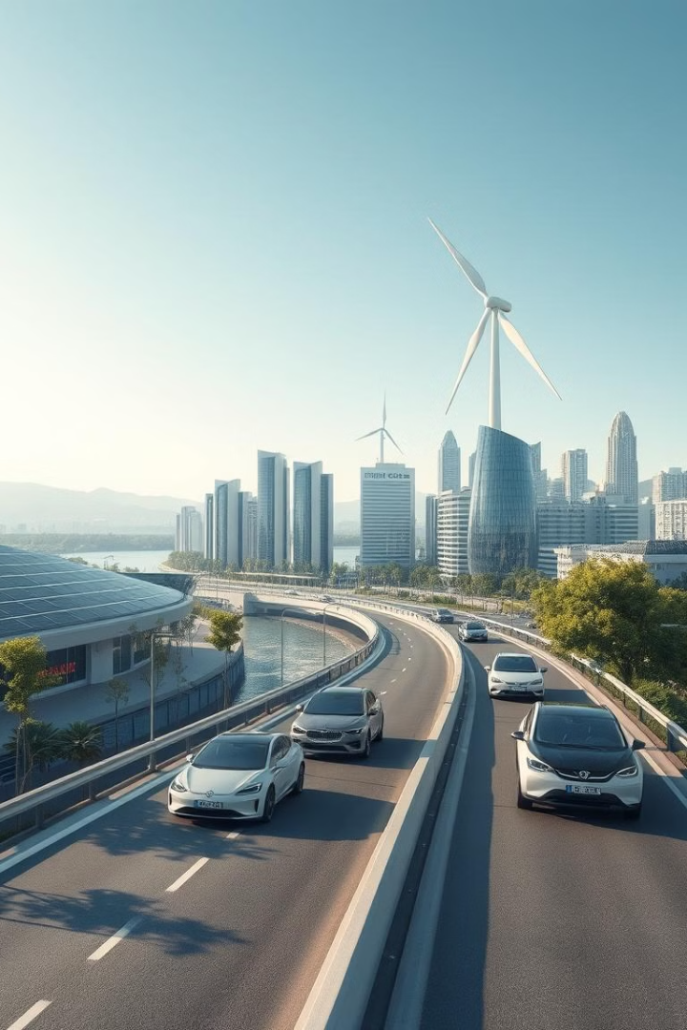
Integrating Generative AI for Environmental Sustainability and Creative AI Innovations
Harnessing the power of generative AI, we can drive breakthroughs in environmental protection, renewable energy, and creative problem-solving to build a more sustainable future.
by SHASHANK KATTI

Slide 2
The Power of AI: GPT, Claude, Gemini, Midjourney, DALL-E
GPT: Natural Language Processing
Claude: Conversational AI
Generative AI: DALL-E, Midjourney, Gemini
Intelligent chatbots and virtual assistants that can engage in natural dialogue and assist with a wide range of tasks.
Powerful language models that can understand, generate, and manipulate human text with impressive fluency.
AI systems that can create original images, music, and other media based on textual prompts, revolutionizing creative workflows.

Slide 3

Leveraging AI for Environmental Problem Solving
Data Analysis
Automated Monitoring
Applying AI to vast datasets on climate, ecosystems, and environmental factors to uncover insights and patterns.
Deploying AI-powered sensors and drones to continuously monitor environmental conditions and detect issues in real-time.
1
2
3
Predictive Modeling
Using AI to build complex models that can forecast environmental changes and simulate the impact of interventions.

Slide 4
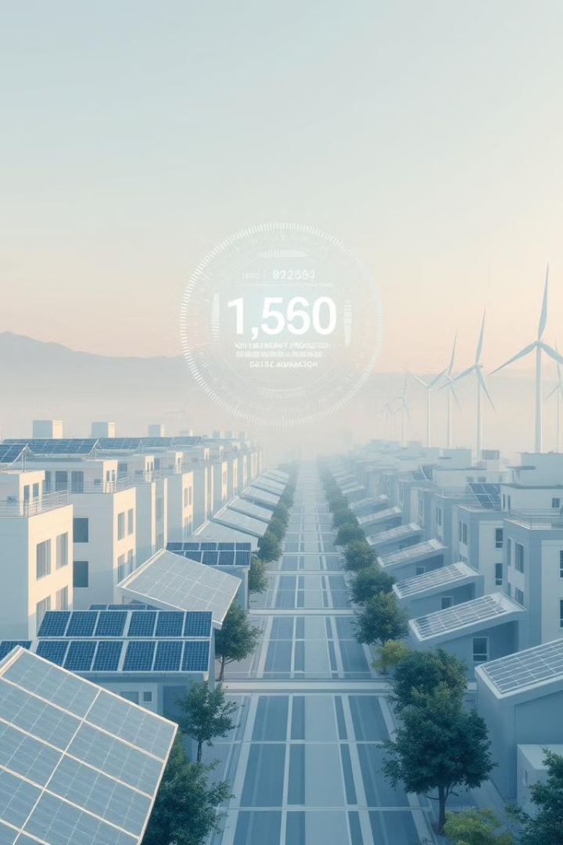
AI-Powered Renewable Energy Solutions
Smart Grids
Predictive Maintenance
AI algorithms optimize the distribution and storage of renewable energy, improving grid efficiency and reliability.
AI-powered systems can predict when renewable energy equipment will need maintenance, reducing downtime and costs.
Resource Allocation
Energy Forecasting
AI models analyze weather patterns and energy demand to optimize the placement and deployment of renewable assets.
AI can accurately predict renewable energy generation, enabling better integration with the power grid.

Slide 5





Generative AI and Sustainable Product Design
Circular Design
Sustainable Materials
Using generative AI to create products that can be easily repaired, recycled, or reused, reducing waste.
Exploring the use of renewable, biodegradable, and low-impact materials for product manufacturing.
Energy Efficiency
Biomimicry
Designing products that consume less energy during use, through smart optimization and AI-driven simulations.
Drawing inspiration from nature to create innovative, sustainable product designs using generative AI.

Slide 6
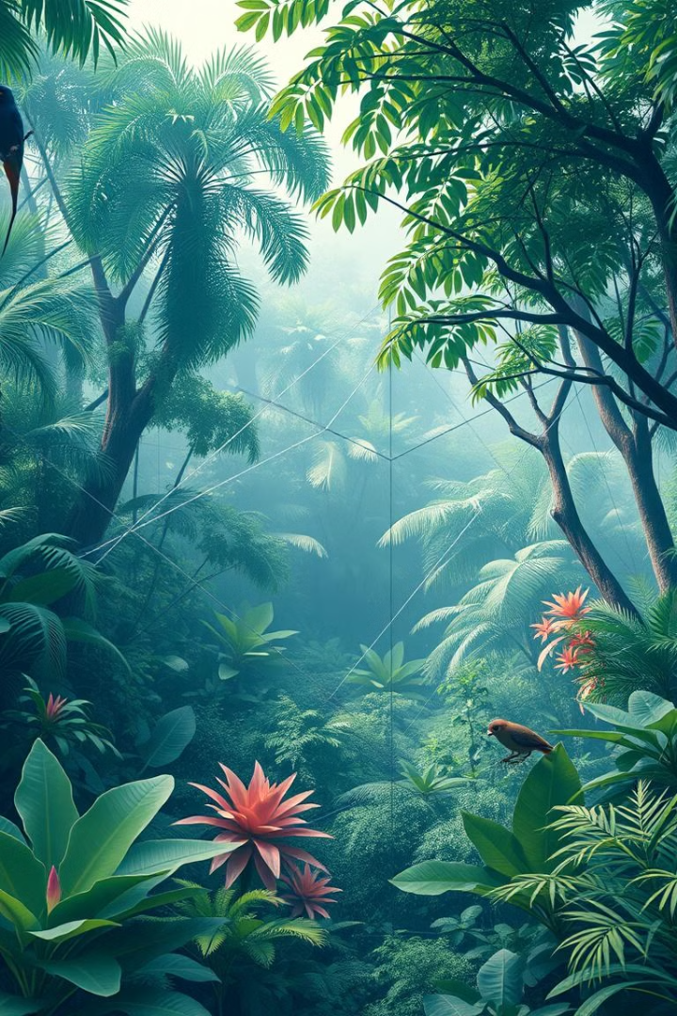



AI-Driven Ecosystem Restoration and Conservation
Habitat Mapping
AI-powered drones and satellite imagery analyze land use and identify areas in need of restoration.
Species Monitoring
AI-enabled cameras and sensors track the presence and behavior of endangered species in real-time.
Predictive Modeling
AI models forecast the impact of conservation efforts and guide decision-making for optimal outcomes.

Slide 7
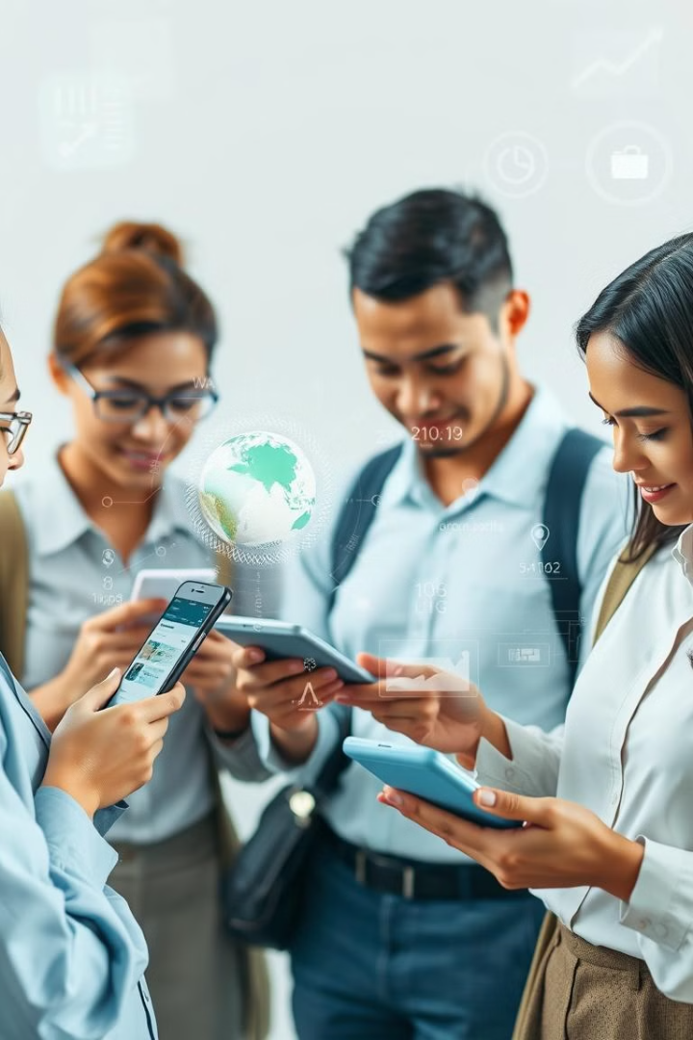
Empowering Citizen Scientists with Generative AI
1
Accessible Data Collection
2
Automated Analysis
Generative AI models can process and interpret the data, providing insights and recommendations.
Citizen scientists can use AI-powered apps to easily capture and contribute environmental data.
3
Collaborative Mapping
AI-driven visualization tools allow citizen scientists to create interactive maps and share their findings.

Slide 8
Creative AI Innovations in Art, Music, and Beyond
Artistic Expression
Musical Composition
Multidisciplinary Applications
Generative AI models can produce unique, imaginative artworks that challenge traditional boundaries.
AI-powered tools can generate original melodies, harmonies, and compositions, inspiring new forms of musical creativity.
Generative AI can be applied to fields like fashion, industrial design, and architecture, unlocking new avenues for innovation.

Slide 9

Responsible AI Development for Sustainable Impact
1
Ethical Principles
2
Inclusive Design
Establishing guidelines and frameworks to ensure generative AI is developed and deployed responsibly.
Involving diverse stakeholders and communities to create AI solutions that address the needs of all people.
3
Environmental Considerations
Prioritizing the environmental impact of AI systems, from energy consumption to material usage.

Slide 10
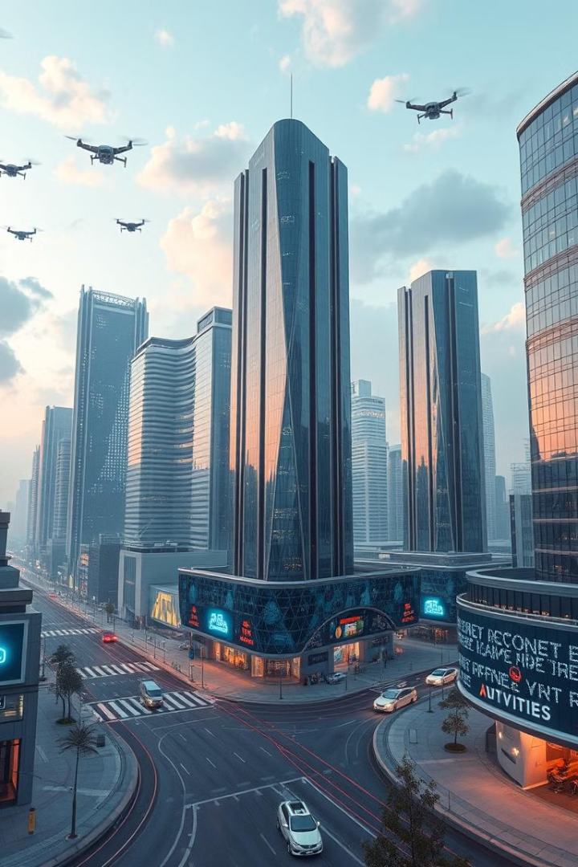
The Future of Generative AI: Opportunities and Challenges
Opportunities
Challenges
Revolutionizing creativity and productivity
Potential for misuse and bias
Driving breakthroughs in sustainability
Ensuring transparency and accountability
Empowering citizen scientists and problem solvers
Addressing concerns about job displacement

